Slide 2
Create a Q&A bot with Amazon Lex and Amazon Alexa
AIM302-R
Bob Strahan
Bob Potterveld
Tom Christensen
AWS ProServe Principal Consultant
Amazon Web Services
AWS ProServe Senior Consultant
Amazon Web Services
AWS ProServe Consultant
Amazon Web Services

Slide 3
Goal
Enable you to deploy a question-and-answer chatbot that supports your business needs on the web, on Amazon Alexa, on Amazon Connect via a call center, and via SMS
Notes:
Our goal for you at the end of this workshop is to have a QnABot up and running ready to handle a workload.
You’ll be able to implement several use cases for this bot and understand how to integrate with additional services.

Slide 4
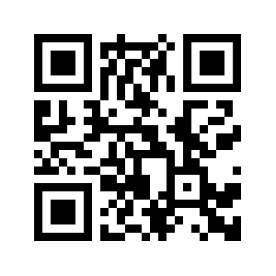
During this workshop, we’ll be using QnABot
QnABot uses Amazon Lex and Amazon Alexa to provide a natural language interface to a question-and-answer knowledge base, so your users can just ask their questions and get quick and relevant answers
Get started quickly with no code!
Information about QnABot is available on the blog post at: https://www.amazon.com/qnabot
Notes:
Before we get into QnABot, I’m curious.. How many of you have build an Alexa Skill before? How many have build a Chatbot using Amazon Lex?
We’re hoping that by the end of our session you’ll all be inspired to try building a Question and Answer bot.. Read our blog - here’s the link. It’s easy – everything is set up for you with a CloudFormation button, and you’ll be up and running, and playing with it in no time.
So what is the QnABot? The name kind of gives it away I think. It’s a bot that tries to answer questions that people ask. And, no, unfortunately it has no magical powers that make it omniscient.. It has to be taught first - we’ll show you how that works in a few minutes..
The code is on GitHub, and we’ve seen a fair amount of community interest from folks asking questions, logging issues, and we’ve even been sent a few pull requests which is cool. It’s like a real open source project.

Slide 5
Workshop agenda
Logistics
Use cases and demos
Architecture
Workshop

Slide 6
Workshop logistics
AWS Event Engine Login – AWS account with preinstalled QnABot stack
https://dashboard.eventengine.run/
Optionally, launch the following stack in your own AWS account. This takes approximately 30 minutes to complete.
https://www.amazon.com/qnabot-launch-stack
Workshop content:
https://www.amazon.com/qnabot-workshop
And then click link to 2019 workshop https://github.com/aws-samples/aws-ai-qna-bot/blob/master/workshops/reinvent2019/readme.md

Slide 7
Demo: QnABot via web UI
Notes:
Have demo site ready and open in a browser. Switch displays if necessary to this browser. Explain what the audience is seeing in the UI. Main website with sun. Chat area. Ask the following questions:
How hot is the sun?
Look at that response. Really cool. Well I guess not that cool but you get the point. (Notice the use of markdown and images in the response - Notice the button to prompt for the next input). These are all features you can easily setup in a qnabot.
How far away is the sun?
How large is the sun? (click on the button)
When did the last solar flares occur? (We just stumbled across dynamic content. You’ll be programming this later as one of the steps in the lab.)

Slide 8
Demo: QnABot on Alexa/Fire TV

Slide 9
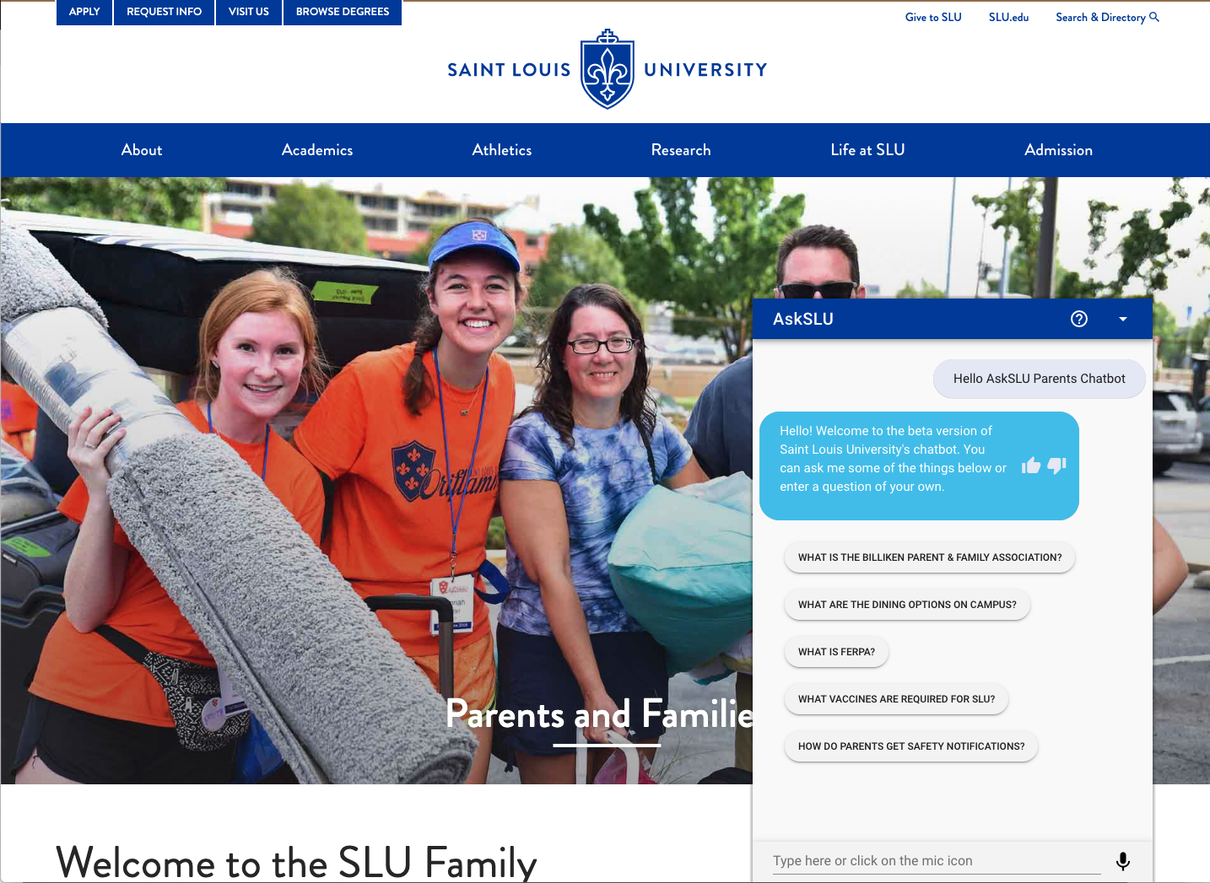
Saint Louis University
https://www.slu.edu/parents
Notes:
Those are some hypothetical examples. How about a real one? Saint Louis University’s AskSLU bot utilizes the QnABot to answer student questions and engage / improve the students campus experience using both Alexa, SMS, and Web integrations.
https://www.slu.edu/parents
Have the web page ready to go.
What are the dining options on campus?
What meals are Vegan at Grand dining hall? Then select Dinner button.
Is the Pius library open?
When will the bus arrive for the Pius library?
What is FERPA?

Slide 10
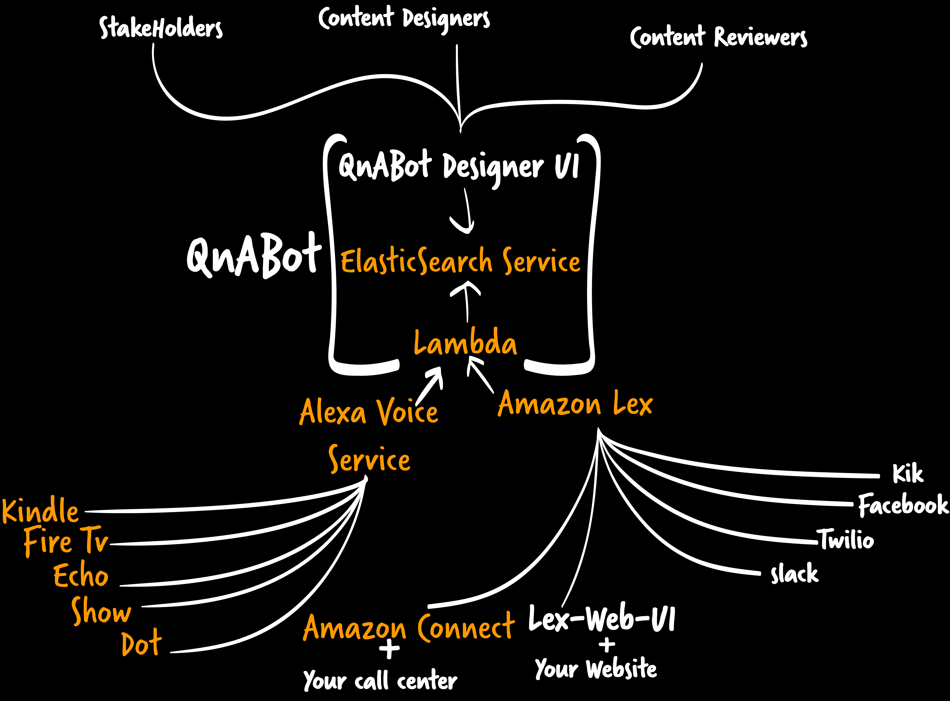
Concept: A room with many doors
Stakeholders
Amazon ES
AWS Lambda
Notes:
When you run a QnABot what does your echo system look like?
Content Designers, Content Reviewers, Stakeholders
Where do you want to expose this information? These are the outbound channels. Explain the possibilities using the Alexa Voice Service and Amazon Lex and Amazon Connect
What manages the orchestrates the implementation? ElasticSearch

Slide 11
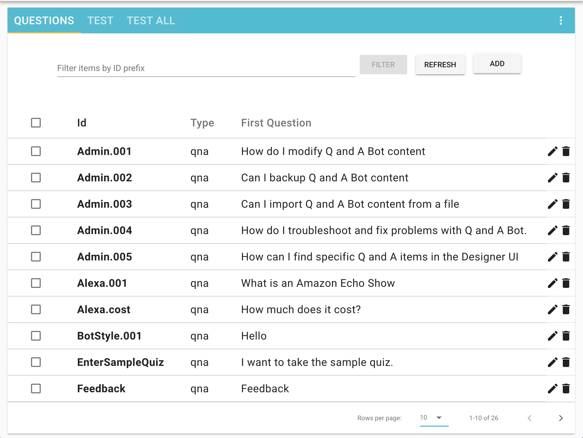
Content designer
Amazon Cognito-based login
Add, edit, delete questions
Filter on question identifiers
Testing questions/ troubleshooting/tuning
Batch testing all questions
Export/backup
Import/restore
Export intents to build an Alexa skill
Notes:
Simple user interface to add questions, answers, response cards.
Group related items into topics
Serve up a quiz
Implement a tour

Slide 12
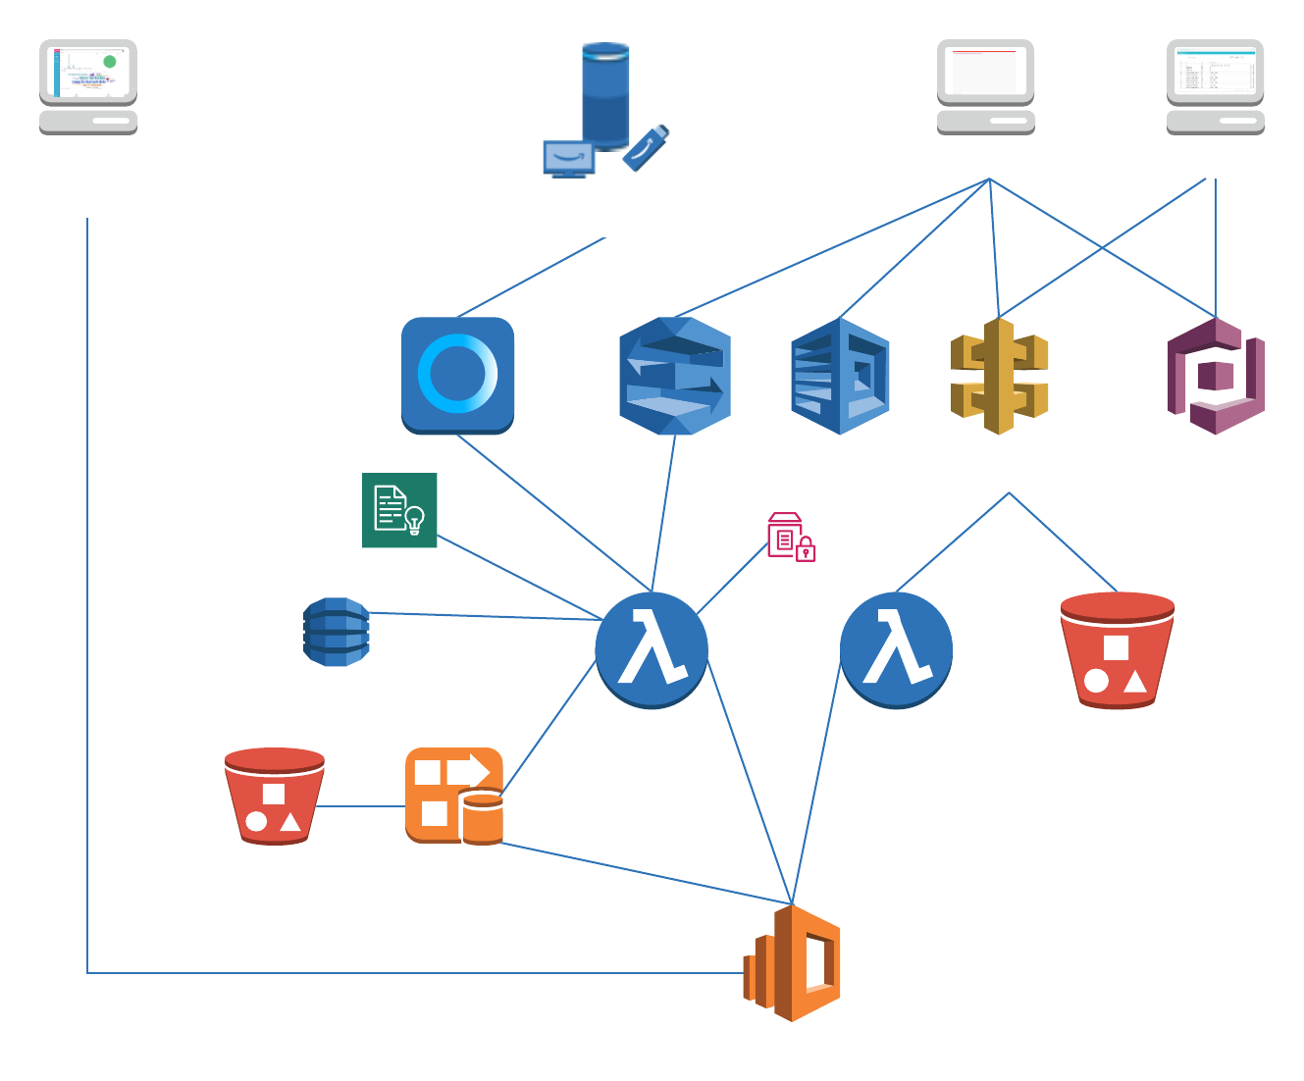
Architecture

Slide 13
Lambda hooks: Enabling advanced use cases
Some questions can’t be answered from static text in Amazon Elasticsearch Service (Amazon ES), such as:
“What time do you close today?”
“When have the last solar flares occurred?”
Introducing Lambda hooks
Extend QnABot with your own Lambda functions
Associate your Lambda to any item in content designer
Your Lambda will be called by QnABot when that item is matched
Your Lambda can either:
Create a dynamic answer (e.g., “What time do you close today?”)
Redirect to a different question (e.g., “Next room or previous room.”)
Lambda hooks can be used for all sorts of things!
Look up external content
Log what the user says/capture feedback
Navigate backward and forward through items
Perform actions based on user command, such as:
- Send email
- Control IoT devices
Route utterance to another bot for specialized handling

Slide 14
Workshop steps
Step 1 – Deploy your own QnABot (already deployed)
Step 2 – Manage questions and answers, test the simple bot
Step 3 – Deploy on your website using the chatbot UI
Optional steps
Step 4 – Integrate QnABot with an Amazon Connect call center
Step 5 – Deploy your QnABot as an Alexa skill
Step 6 – Integrate QnABot with SMS (using Twilio)
Step 7 – Monitor QnABot usage and user feedback using Kibana
Step 8 – Customize QnABot with Lambda
Workshop cleanup
Notes:
s

Slide 15
Start the workshop
Workshop instructions
https://www.amazon.com/qnabot-workshop and click the link to 2019 instructions, or use the following:
https://github.com/aws-samples/aws-ai-qna-bot/blob/master/workshops/reinvent2019/readme.md

Slide 16
Learn ML with AWS Training and Certification
The same training that our own developers use, now available on demand
Role-based ML learning paths for developers, data scientists, data platform engineers, and business decision makers
70+ free digital ML courses from AWS experts let you learn from real-world challenges tackled at AWS
Validate expertise with the
AWS Certified Machine Learning - Specialty exam
Visit https://aws.training/machinelearning
Notes:
Machine Learning Track – Margaux Logan
Speaker Notes:
You came to re:Invent to learn. There’s no need to stop when you go home.
Keep re:Inventing with resources from AWS Training and Certification for Machine Learning - for you and your teams
We offer over 70 courses, available free and on-demand, as well as classroom offerings. Our role-based learning paths make it easy to find the courses for you. And the AWS Certified Machine Learning – Specialty exam validates your skills and provides an industry-recognized credential.
For more information, visit https://aws.training/machinelearning.

